Slide 1

Computer Science & Engineering
Human Detection
From Aerial Images Using Yolo-V5
Presented By –
Ashutosh Jena Sweta Singh
Bidwan Charan Panda Priyanka Behera
UNDER THE GUIDANCE
Dr. Sourav Ku. Bhoi
Assistant Professor
PARALA MAHARAJA ENGINEERING COLLEGE, SITALAPALLI, BERHAMPUR, ODISHA, 761003

Slide 2
Computer Science & Engineering
Contents:
Object Detection
Object Detection Methods
The Yolo Family
Yolo V5
Data Collection And Formatting
Detected Results
Results
Conclusions
References
PARALA MAHARAJA ENGINEERING COLLEGE, SITALAPALLI, BERHAMPUR, ODISHA, 761003

Slide 3
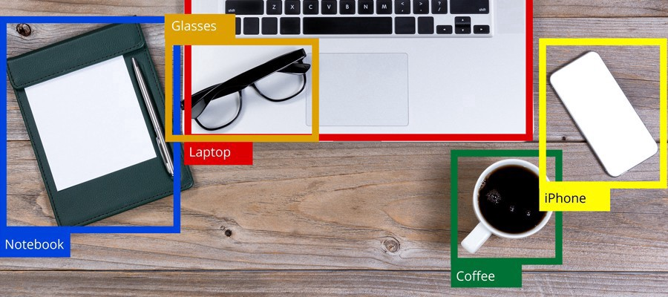
Computer Science & Engineering
Object Detection:
Object detection is a computer vision technique for locating instances of objects in images or videos. Object detection algorithms typically leverage machine learning or deep learning to produce meaningful results. When humans look at images or video, we can recognize and locate objects of interest within a matter of moments. The goal of object detection is to replicate this intelligence using a computer.
PARALA MAHARAJA ENGINEERING COLLEGE, SITALAPALLI, BERHAMPUR, ODISHA, 761003

Slide 4
Computer Science & Engineering
Object Detection Methods:
Machine Learning Methods:
Viola–Jones object detection framework based on Haar features
Scale-invariant feature transform (SIFT)
Histogram of oriented gradients (HOG) features
Deep Learning Methods:
Region Proposals (R-CNN, Fast R-CNN, Faster R-CNN)
Single Shot MultiBox Detector (SSD)
You Only Look Once (Yolo) Family
Single-Shot Refinement Neural Network for Object Detection (RefineDet)
Retina-Net
Deformable convolutional networks
DEtection TRansformer (DETR)
PARALA MAHARAJA ENGINEERING COLLEGE, SITALAPALLI, BERHAMPUR, ODISHA, 761003

Slide 5
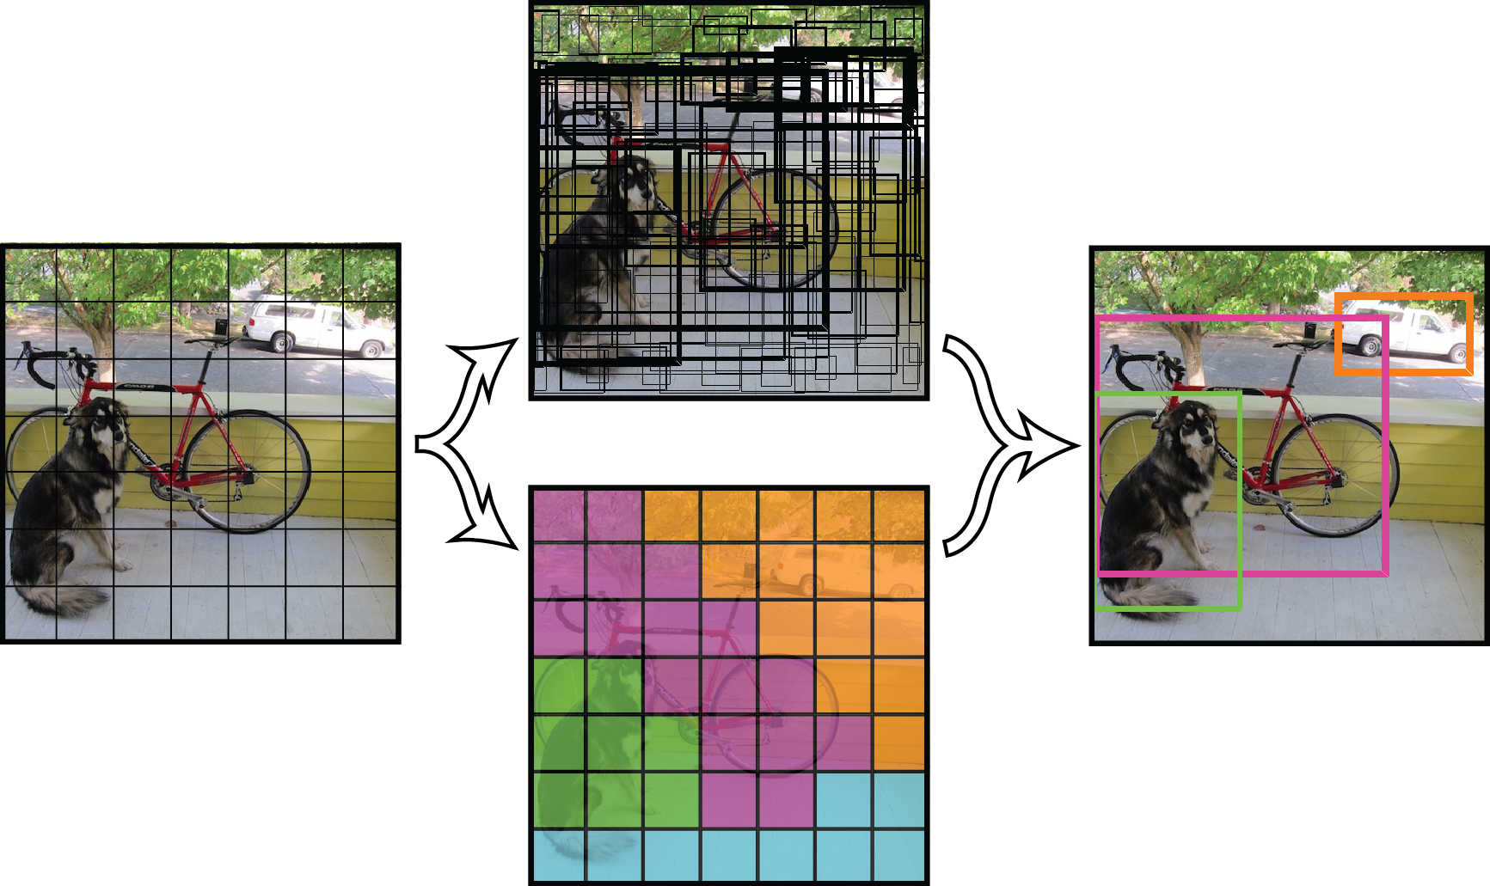
Computer Science & Engineering
The Yolo Family:
Yolo
CNN used - DarkNet
26 Total Layers
24 Convolutional Layers
2 Fully Connected Layers
PARALA MAHARAJA ENGINEERING COLLEGE, SITALAPALLI, BERHAMPUR, ODISHA, 761003

Slide 6
Computer Science & Engineering
Yolo V2
CNN used DarkNet
30 Layers
Concept of Anchor Boxes
No Fully Connected Layers Present
Problem in detection of small objects
Yolo V3
CNN used DarkNet
106 Layers
Detection on 3 scales of objects
Good in small object detection
Yolo V4
Cross-Stage-Partial-Connections (CSP), A new backbone that can enhance learning capability of CNNDetection on 3 scales of objects
Mosaic data augmentation, represents a new data augmentation method that mixes 4 training images instead of a single image
PARALA MAHARAJA ENGINEERING COLLEGE, SITALAPALLI, BERHAMPUR, ODISHA, 761003

Slide 7
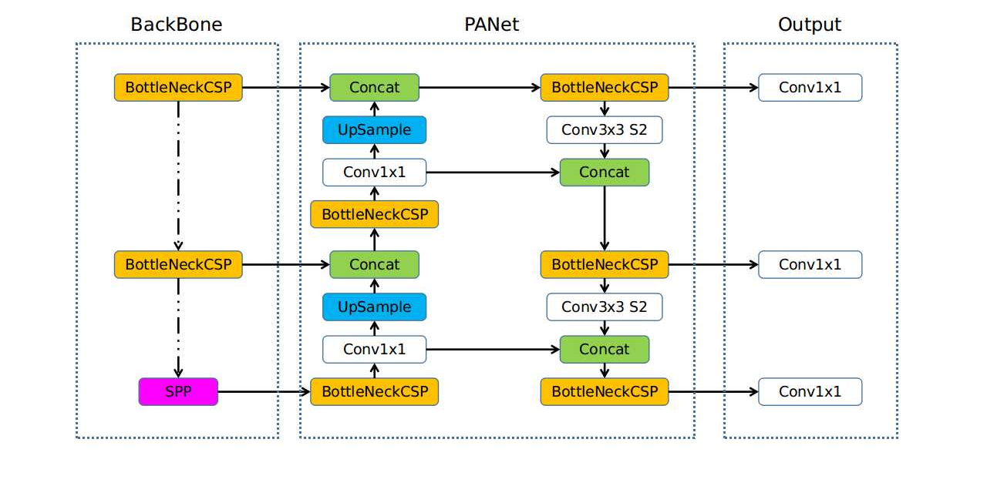
Computer Science & Engineering
Yolo V5
PARALA MAHARAJA ENGINEERING COLLEGE, SITALAPALLI, BERHAMPUR, ODISHA, 761003

Slide 8
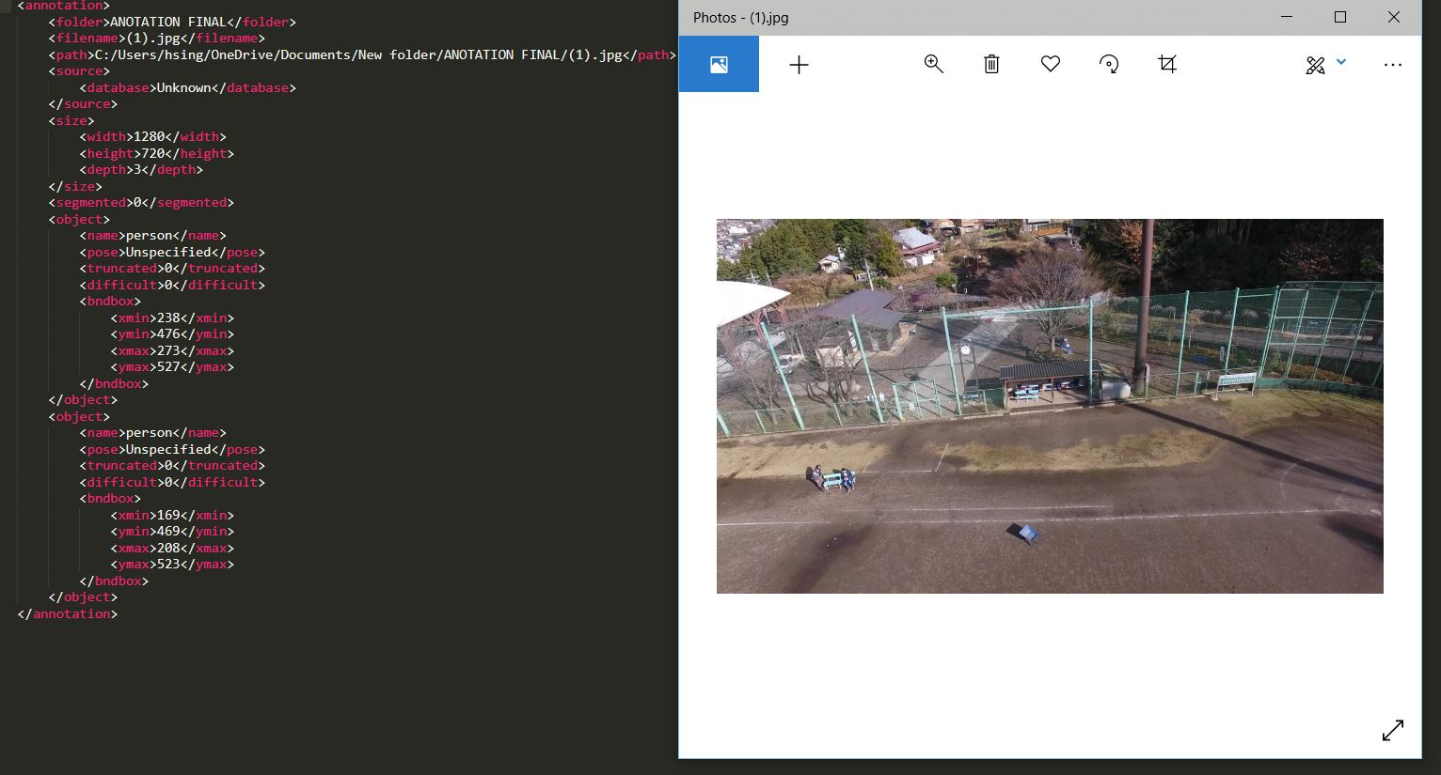
Data Collection :
Aerial Image Dataset – Kaggle
Format – PASCAL VOC

Slide 9
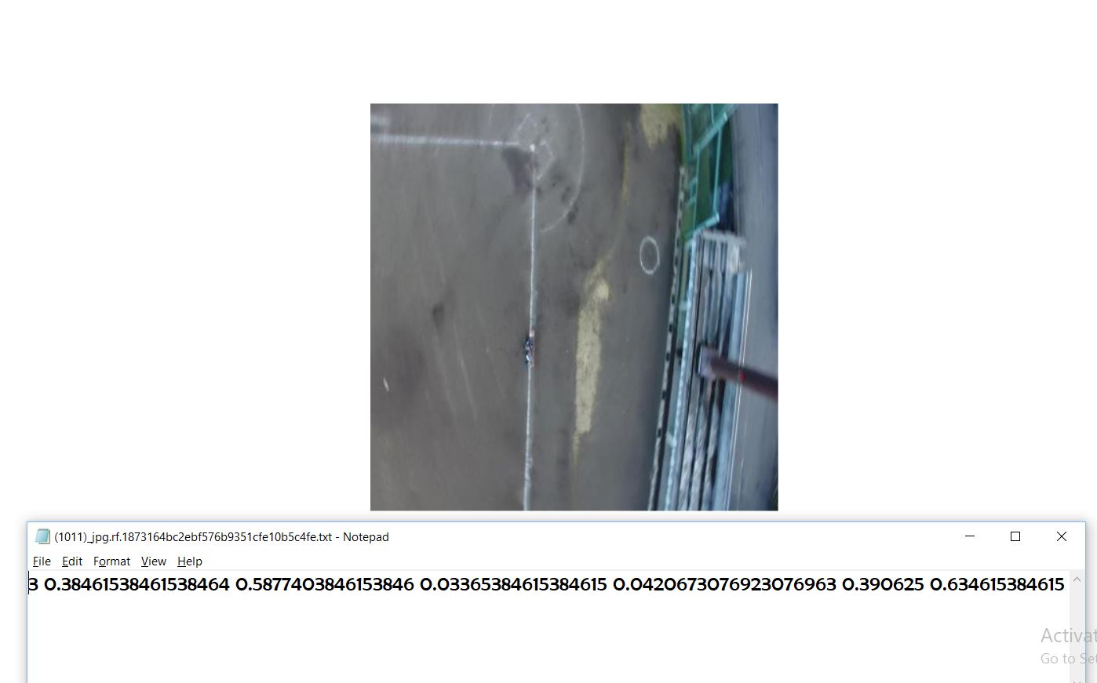

Slide 10
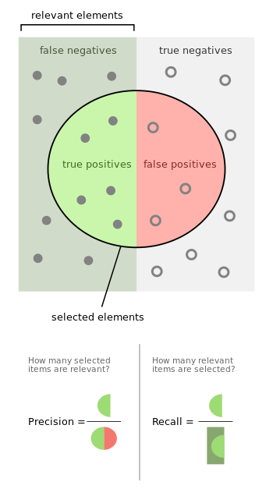
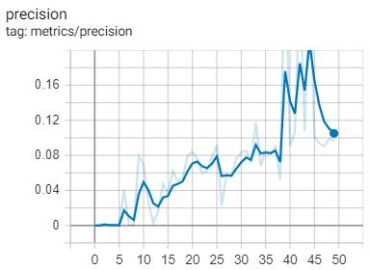
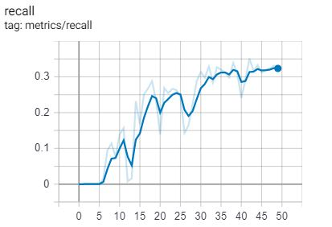
Computer Science & Engineering
Results :
PARALA MAHARAJA ENGINEERING COLLEGE, SITALAPALLI, BERHAMPUR, ODISHA, 761003

Slide 11
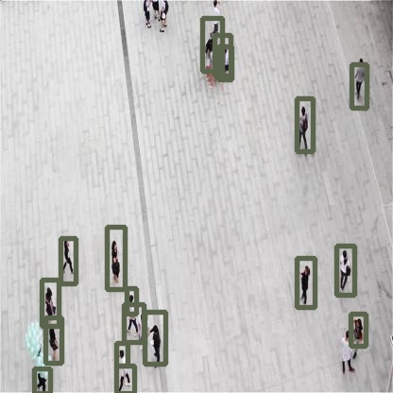
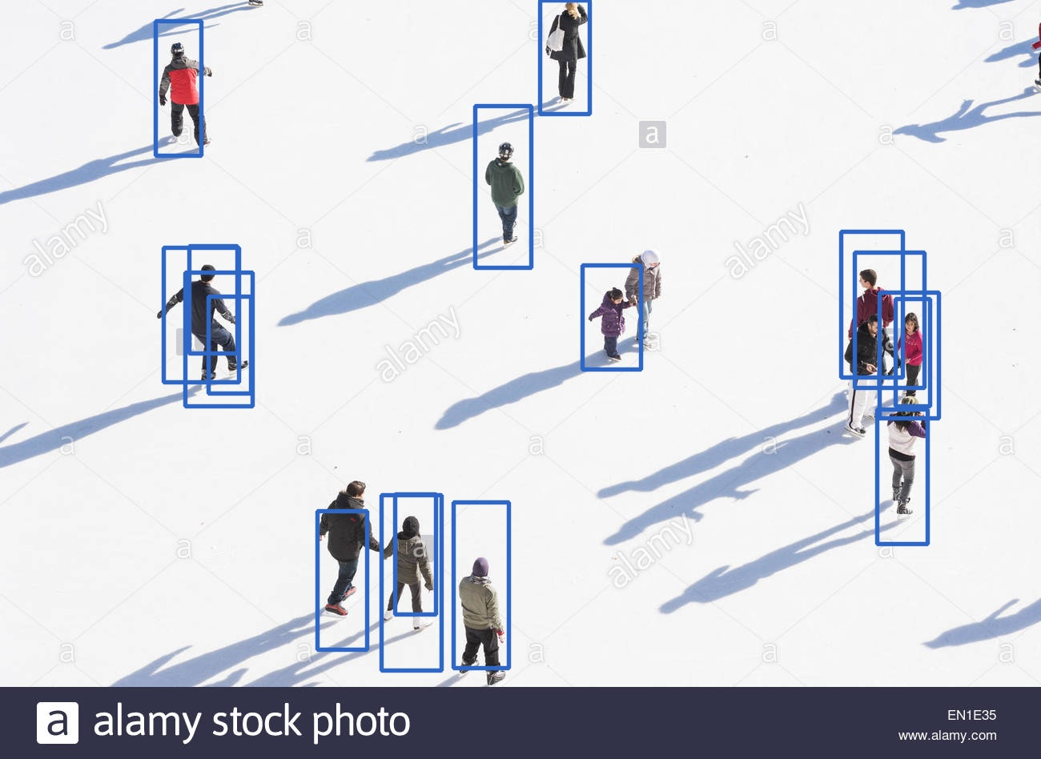
Detected Results :

Slide 12
Computer Science & Engineering
Conclusion :
The Yolo V5 performs very well even in power-constrained GPUs.
The use of CSP has reduced computational speed and resulted in more FPS detection.
There are 4 Models developed, 5s, 5m, 5l and 5x. Depending upon the requirement any of the models can be used.
The model used in this project is 5s. It is the smallest among them and the trained model is only ~27 MBs.
The model has been trained only on aerial data, and the predictions are phenomenal.
PARALA MAHARAJA ENGINEERING COLLEGE, SITALAPALLI, BERHAMPUR, ODISHA, 761003

Slide 13
Computer Science & Engineering
References :
Redmon, J., Divvala, S., Girshick, R., & Farhadi, A. (2016). You only look once: Unified, real- time object detection. In Proceedings of the IEEE conference on computer vision and pattern recognition (pp. 779-788).
Redmon, J., & Farhadi, A. (2017). YOLO9000: better, faster, stronger. In Proceedings of the IEEE conference on computer vision and pattern recognition (pp. 7263-7271).
Redmon, J., & Farhadi, A. (2018). Yolov3: An incremental improvement. arXiv preprint arXiv:1804.02767.
[Medium] YOLO V5 — Explained and Demystified
Bochkovskiy, A., Wang, C. Y., & Liao, H. Y. M. (2020). YOLOv4: Optimal Speed and Accuracy of Object Detection. arXiv preprint arXiv:2004.10934.Spatial Pyramid Pooling in Deep Convolutional Networks for Visual Recognition
Ultralytics Open Source Projects
He, K., Zhang, X., Ren, S., & Sun, J. (2015). Spatial pyramid pooling in deep convolutional networks for visual recognition. IEEE transactions on pattern analysis and machine intelligence, 37(9), 1904-1916.
PARALA MAHARAJA ENGINEERING COLLEGE, SITALAPALLI, BERHAMPUR, ODISHA, 761003

